Slide 1
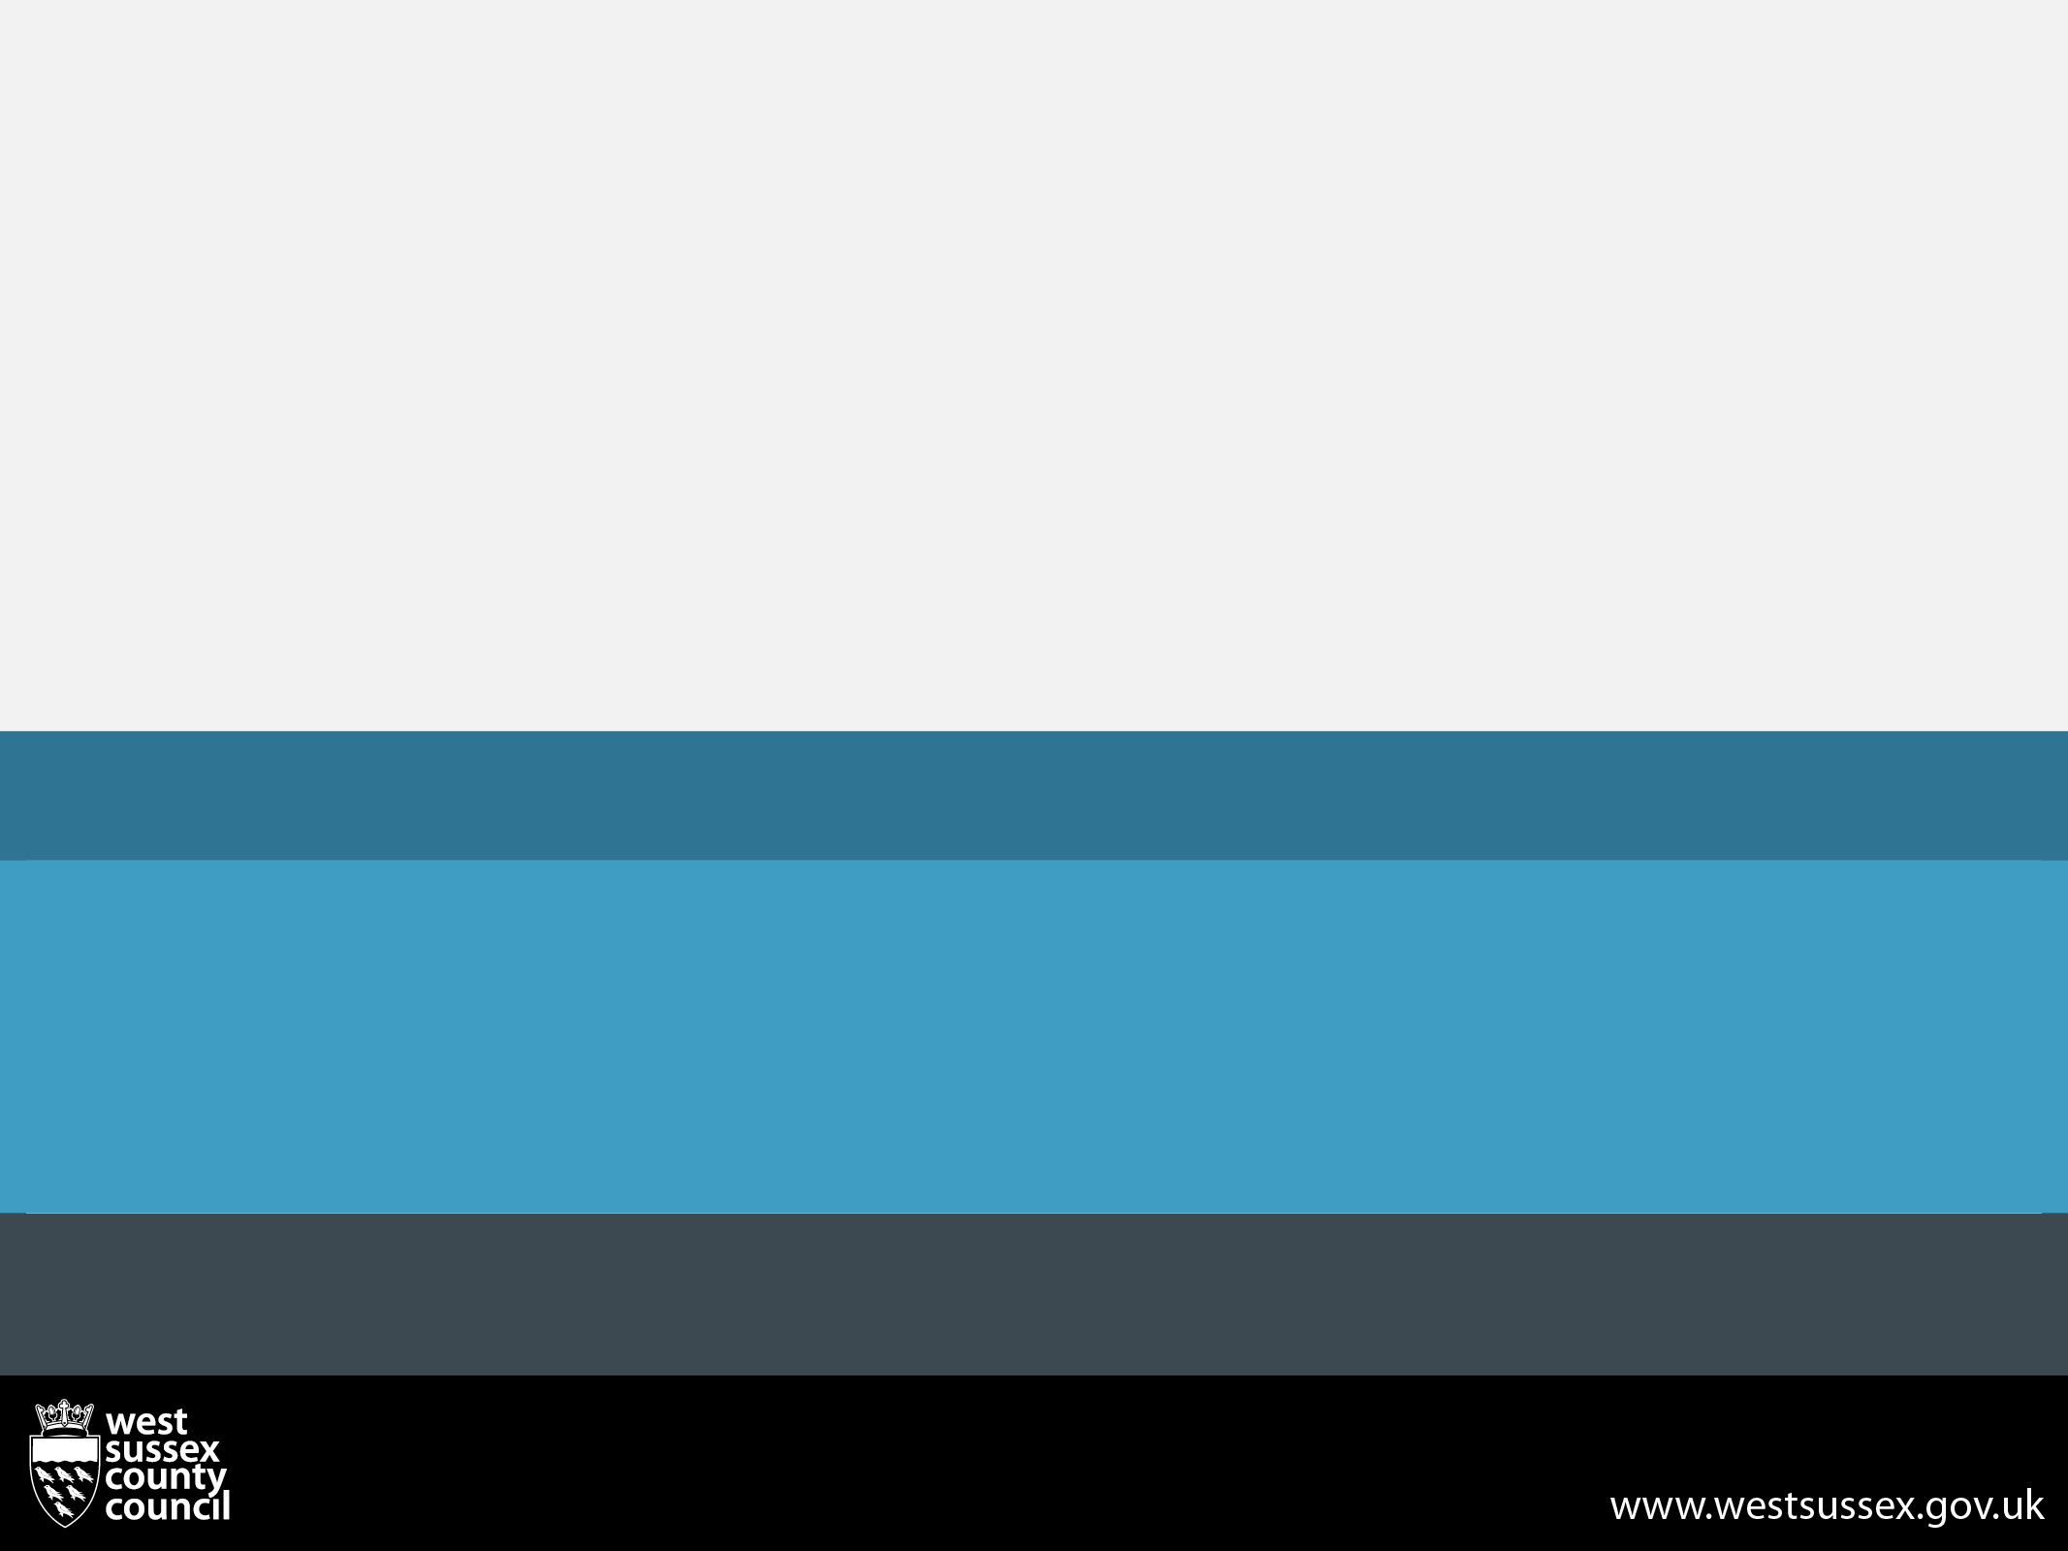
West Sussex Annual Public Health Report
Looking Through a Public Health Lens
Anna Raleigh, Director of Public Health
Date

Slide 2
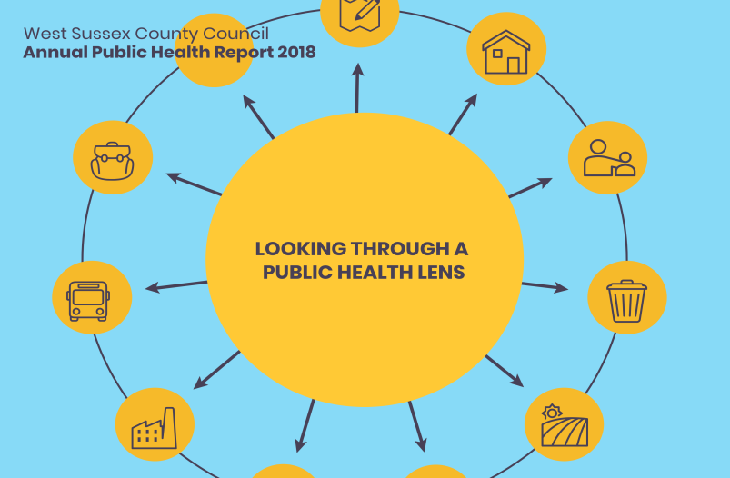
What is a Annual Public Health Report?
Director of Public Health (DPH) has a statutory duty to write an Annual Public Health Report.
To detail the state of health within the local population
Report is independent view of the DPH
Can highlight a specific issue, act as advocacy for the health of the population.
Aimed at variety of audiences (and general lay audience)
Looking Through a Public Health Lens

Slide 3
Key Messages
Need to live healthier - not just longer lives
Benefits need to be felt by all – West Sussex has considerable inequalities in health
Life expectancy is 7.6 years lower for men in the most deprived areas (compared with least deprived areas) and 6.4 years lower for women.
At county level 1 in 10 children live in poverty but in the most deprived areas this is 1 in 3
Public Health is everyone’s business
Health is not just about Healthcare

Slide 4
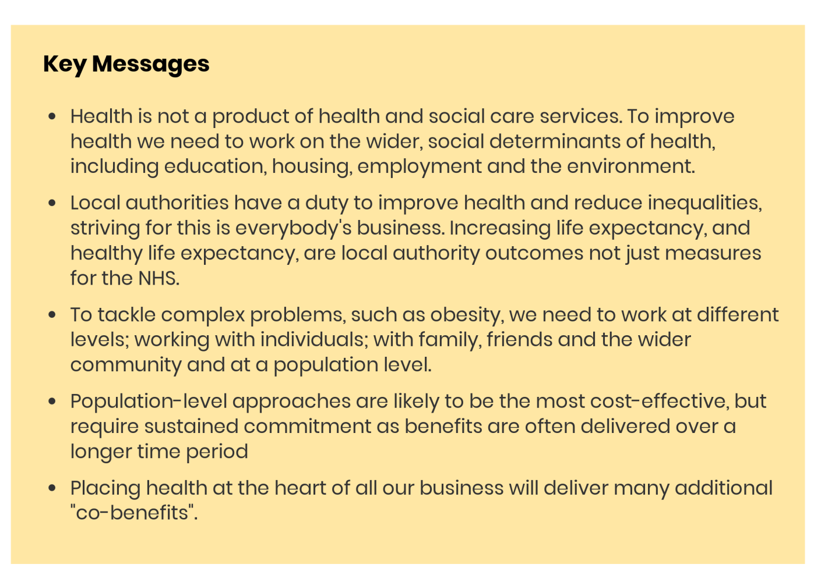

Slide 5
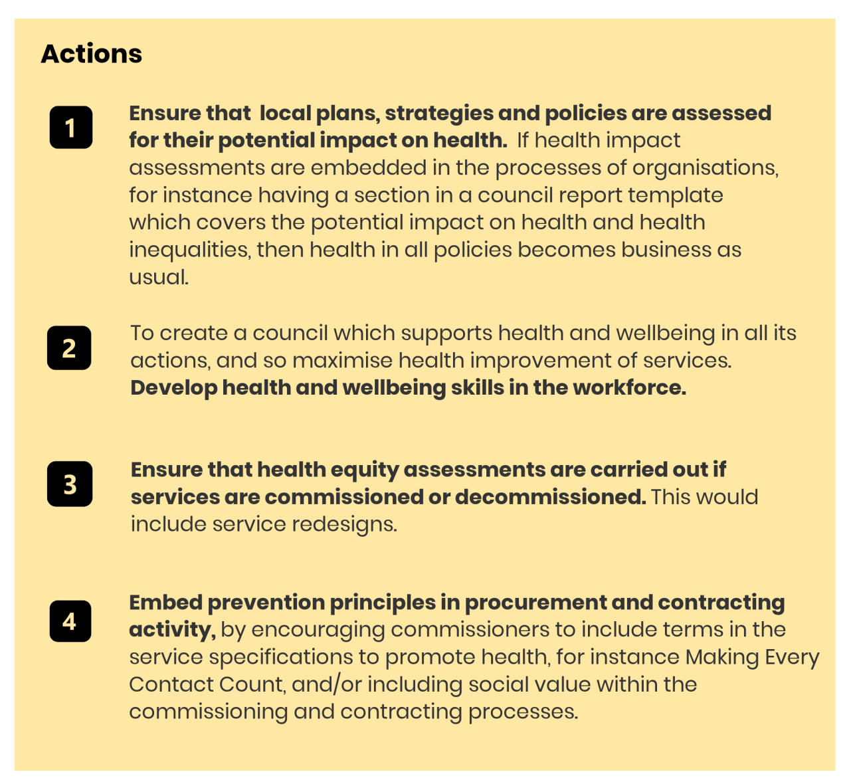

Slide 6
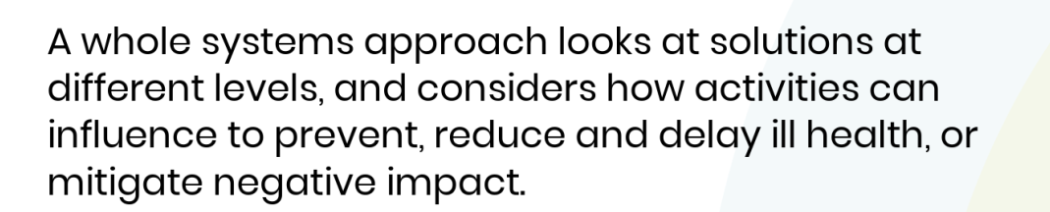

A Whole Systems Approach to Public Health

Slide 7
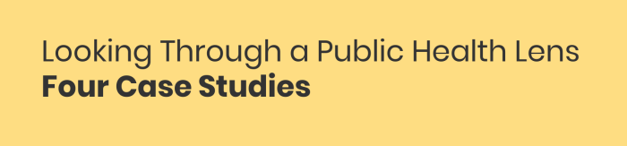
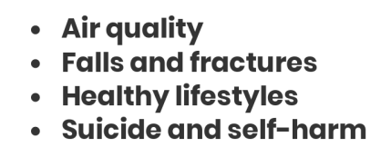
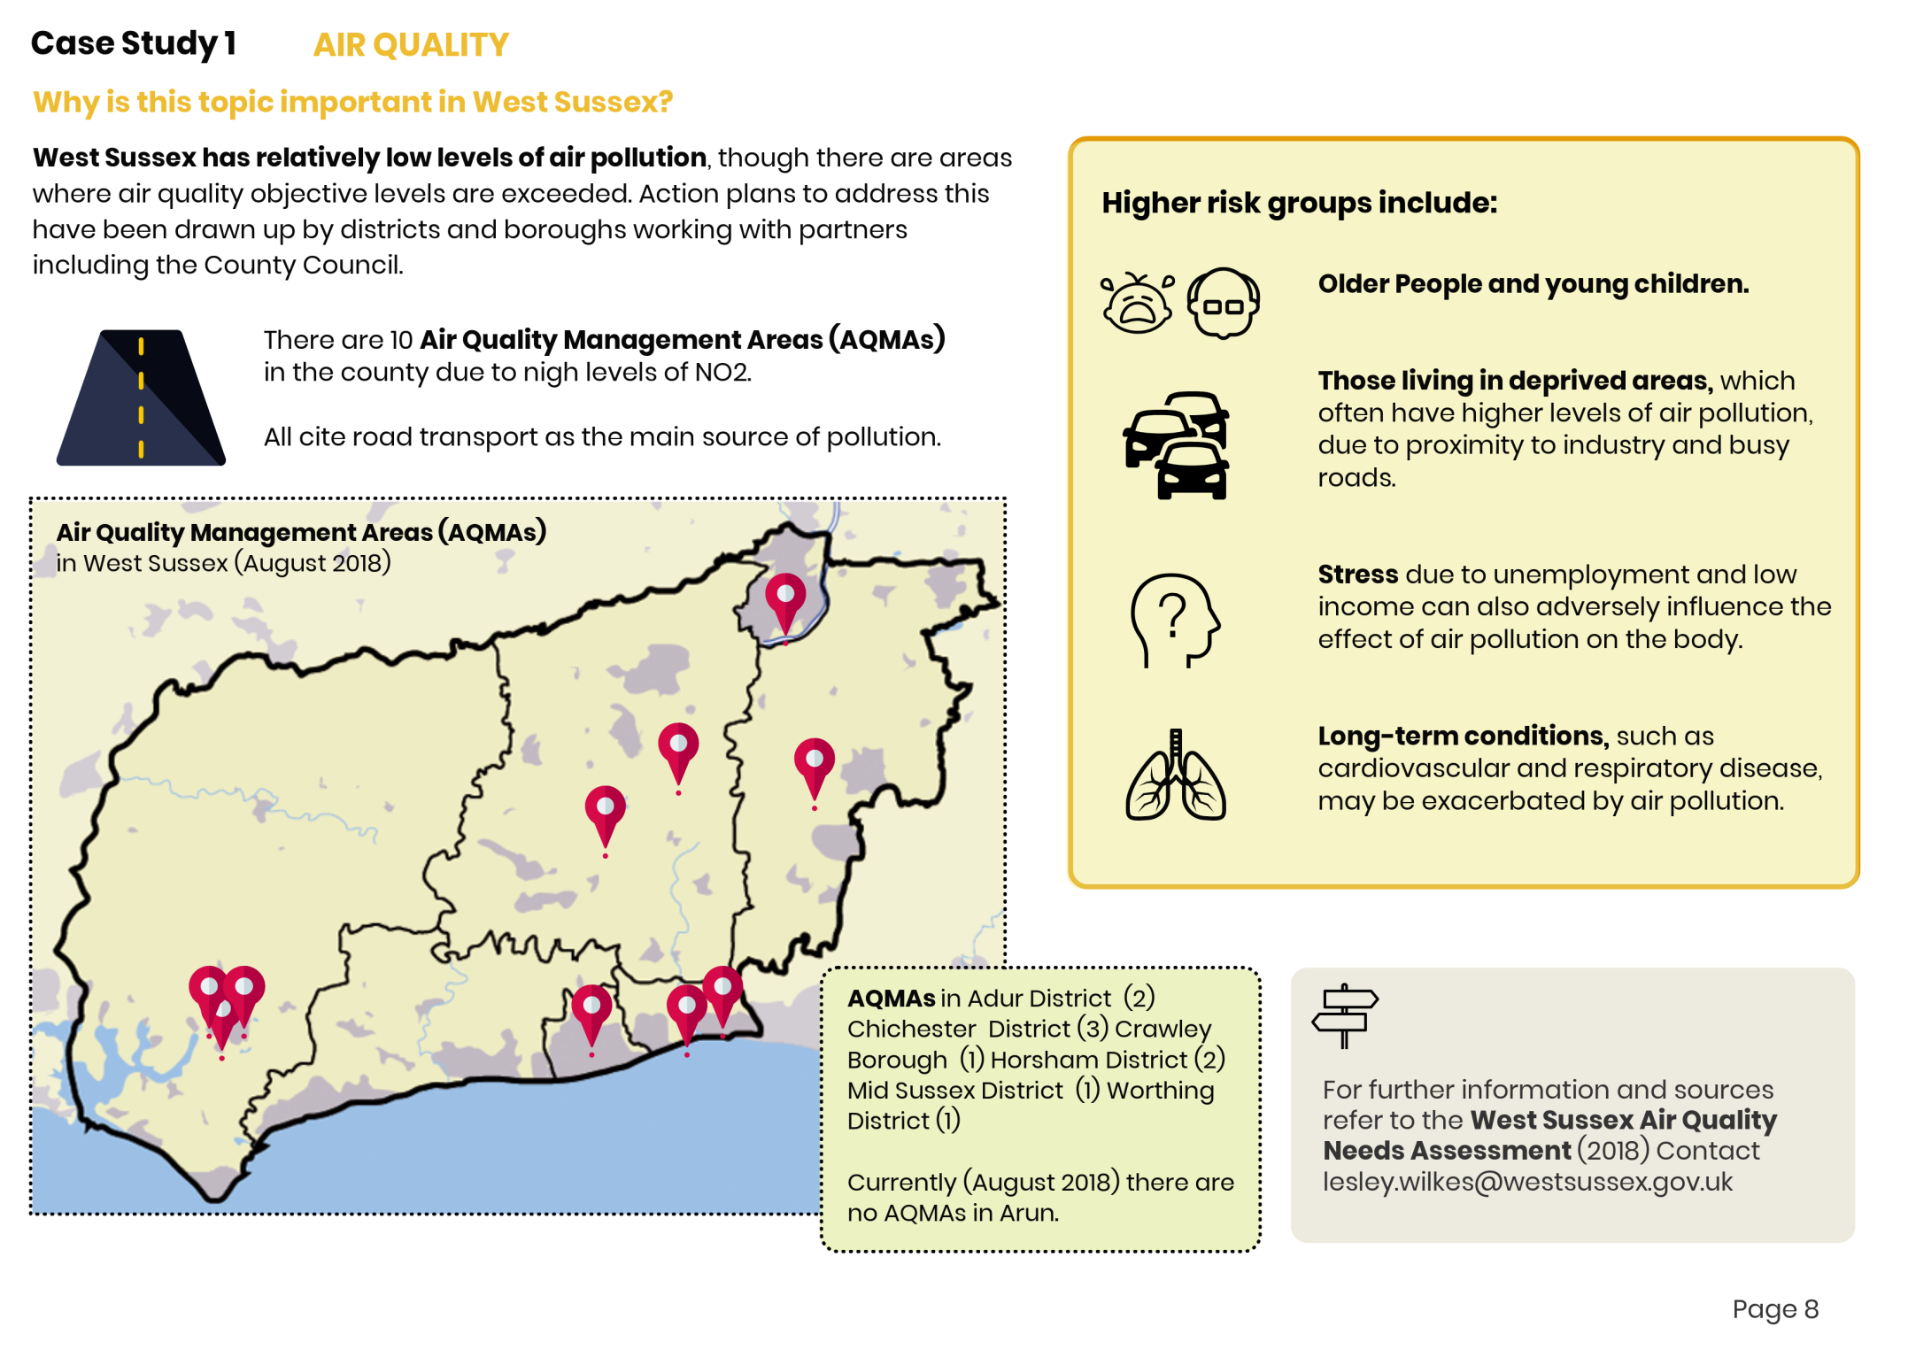
For each case study…why it is important…..

Slide 8
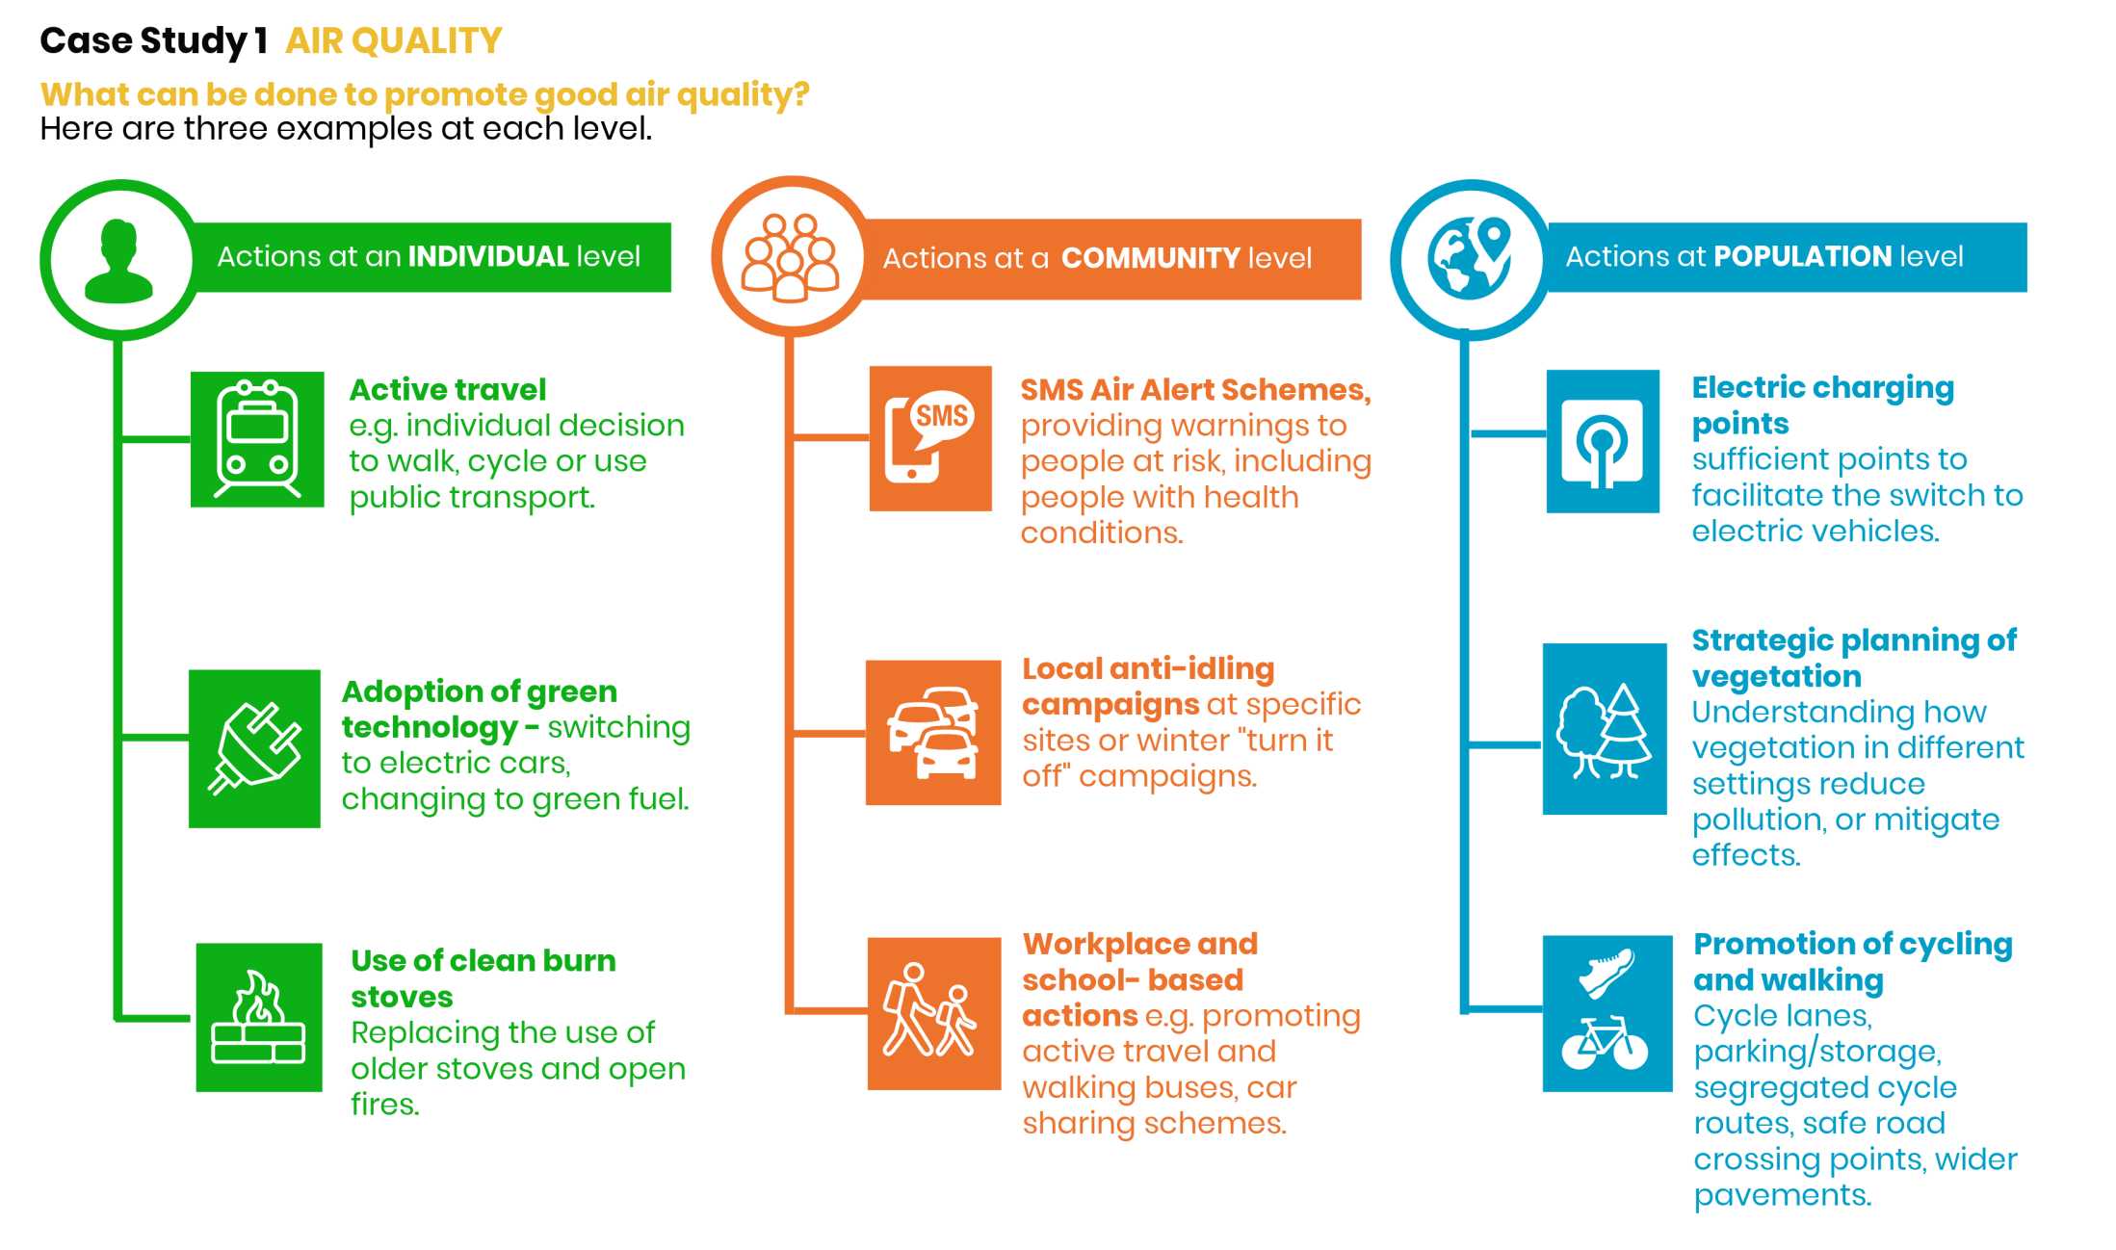
….for each case study, 3 examples of effective action at individual, community and population levels

Slide 9
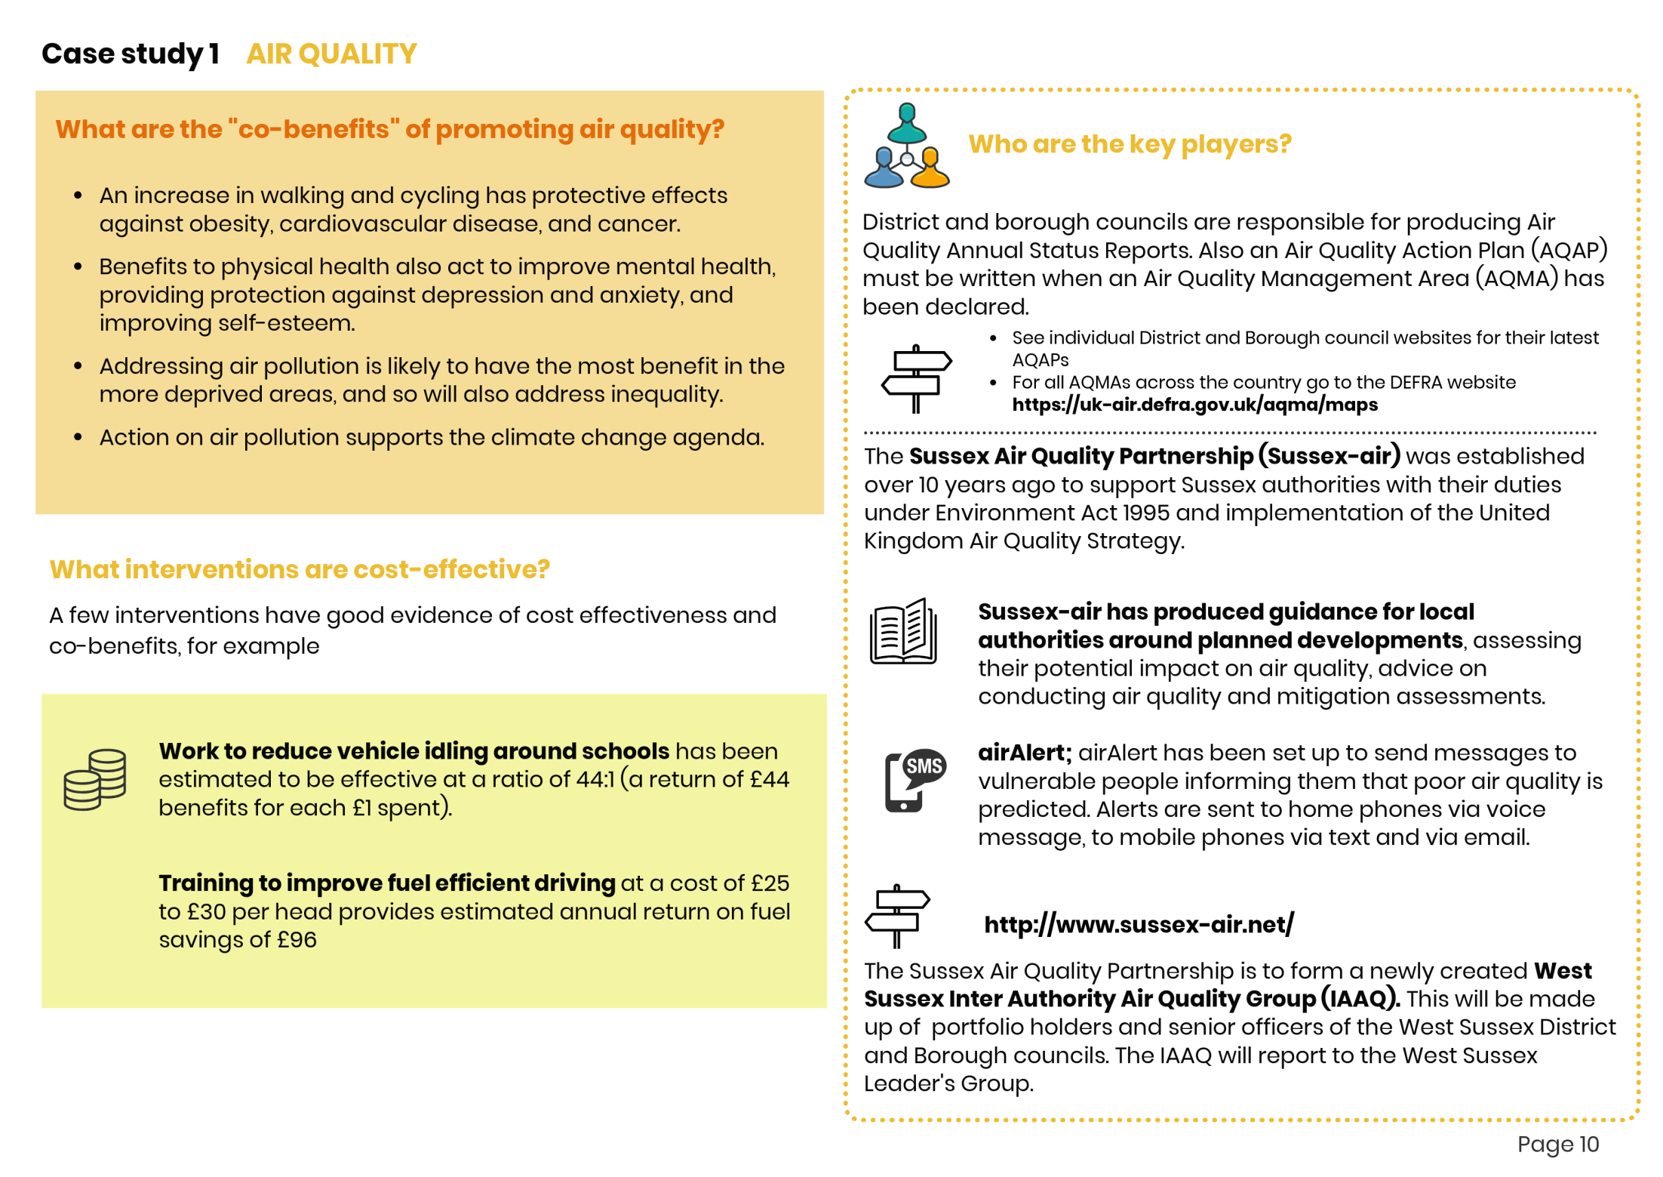
Co-benefits…..

Slide 10
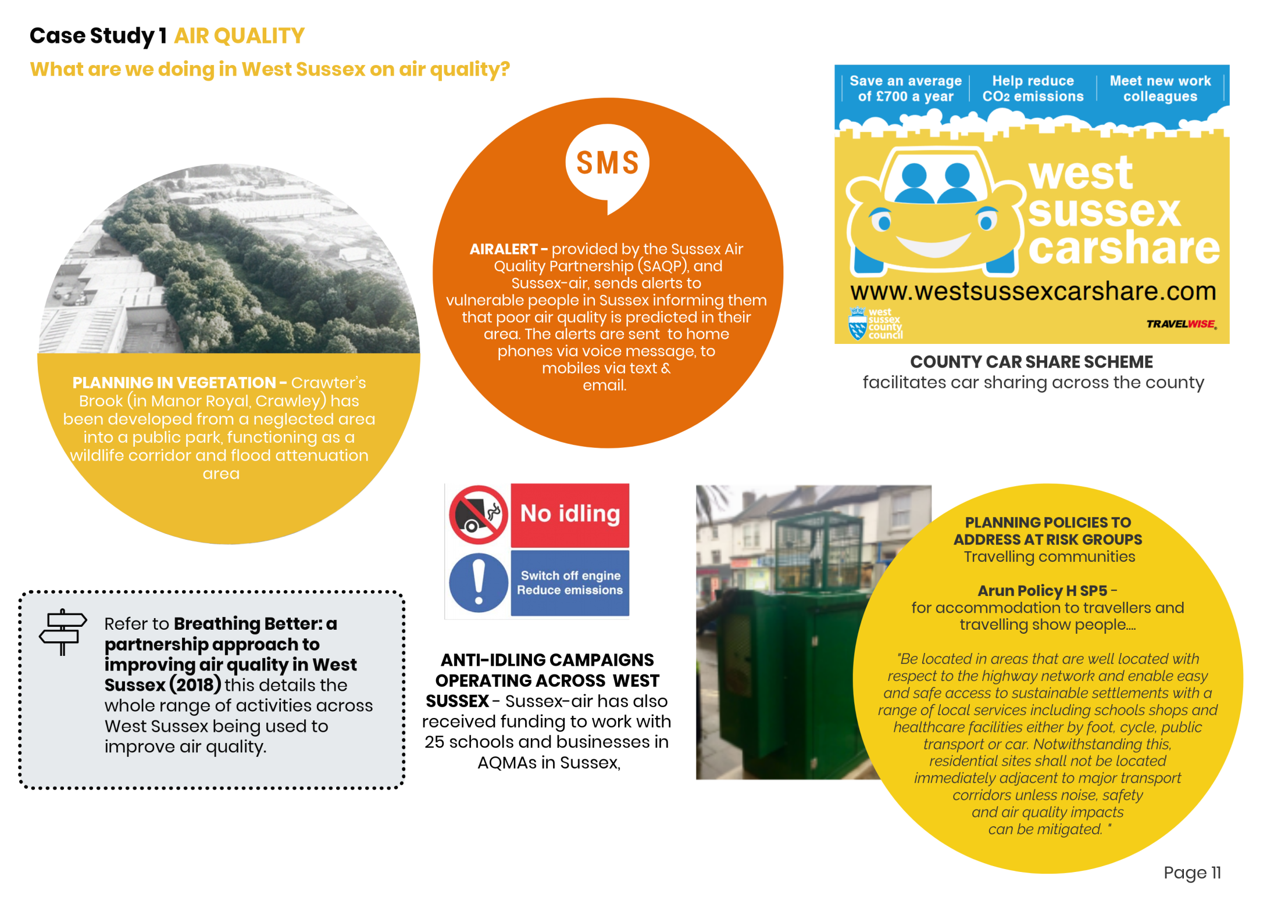
….what is happening locally?

Slide 11
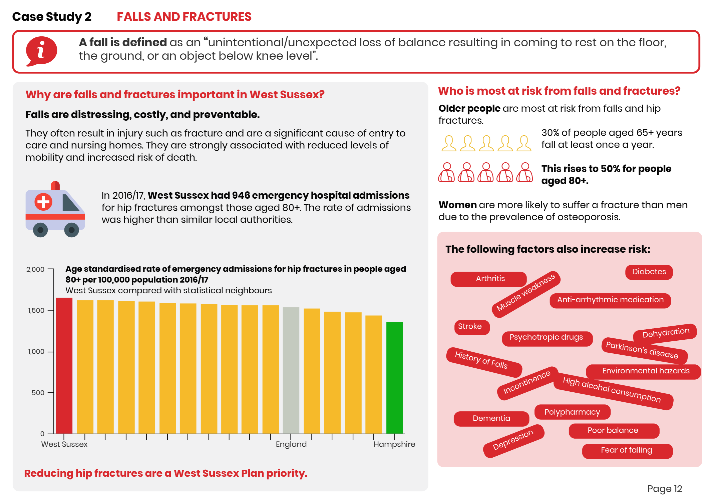
Example 2 – Falls and Fractures

Slide 12
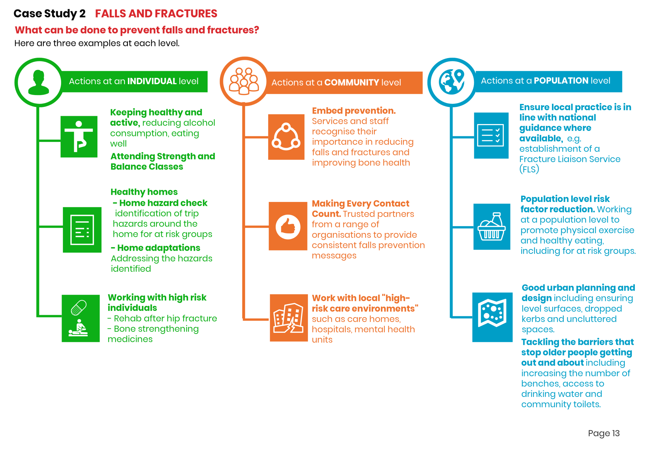

Slide 13
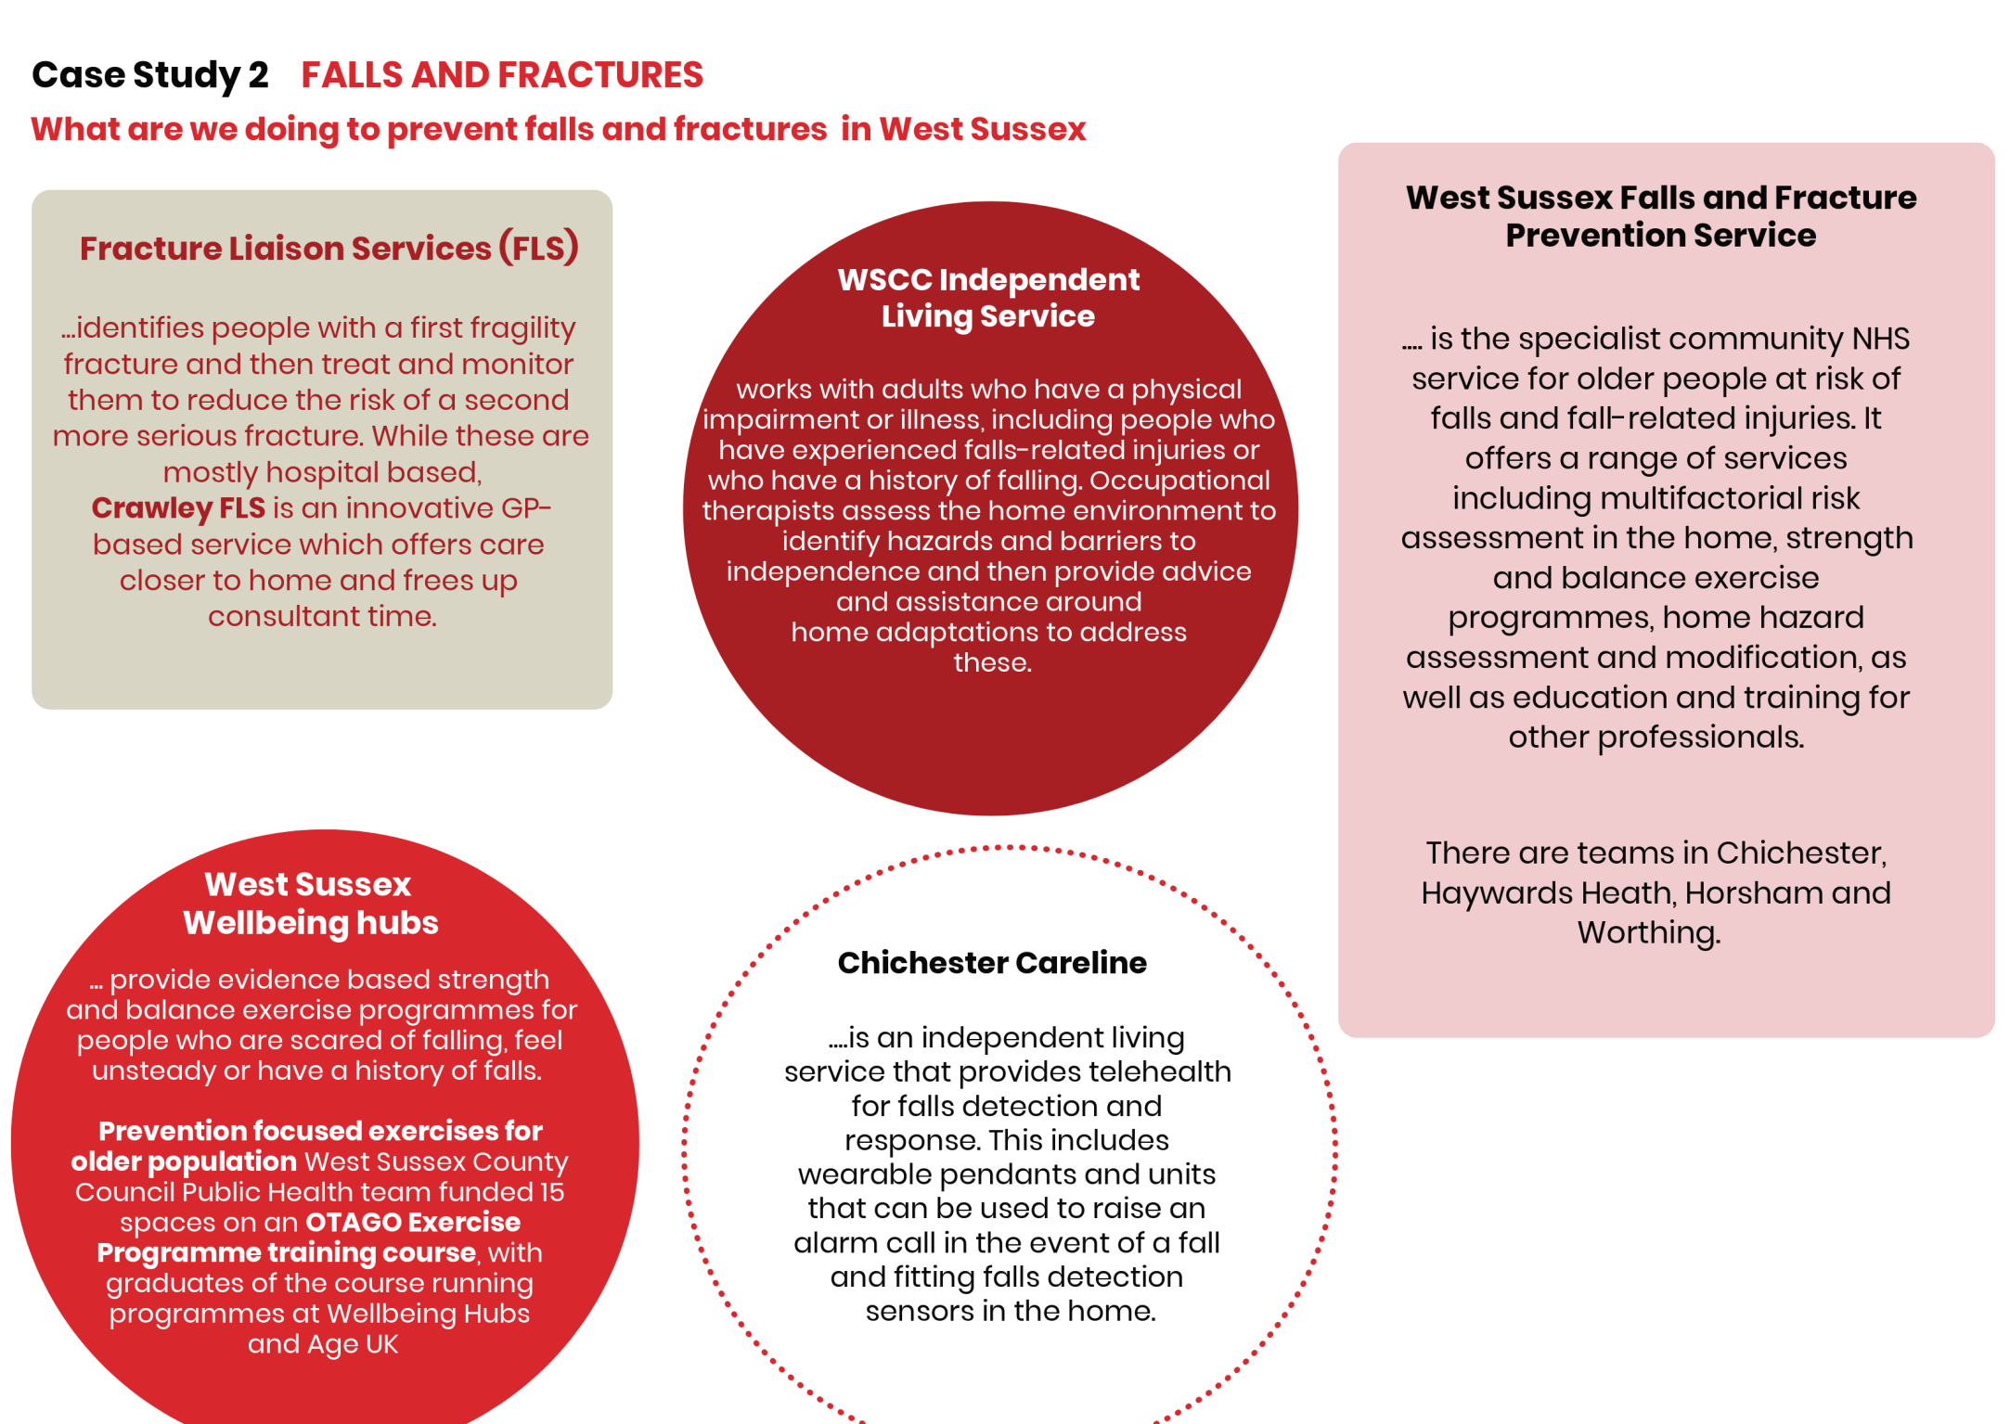

Slide 14
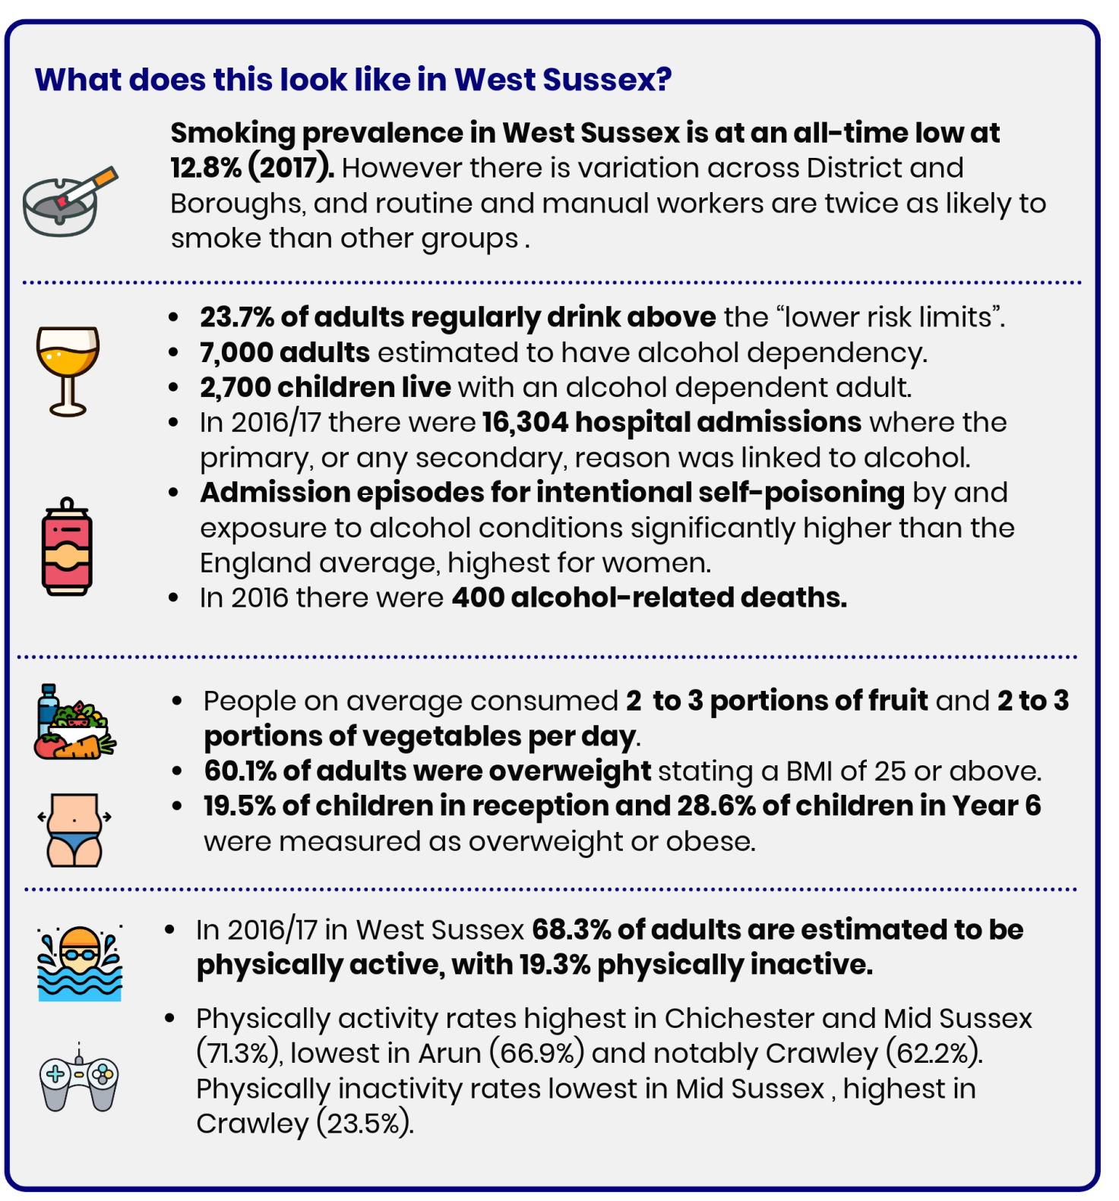
Unhealthy behaviours

Slide 15
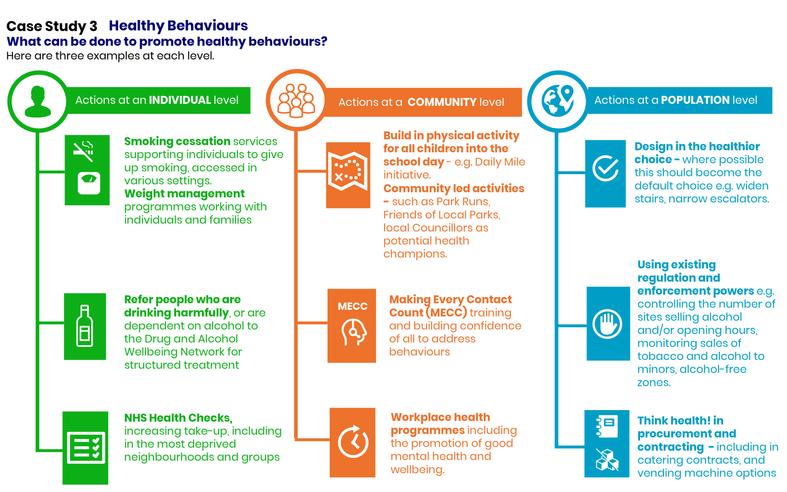

Slide 16
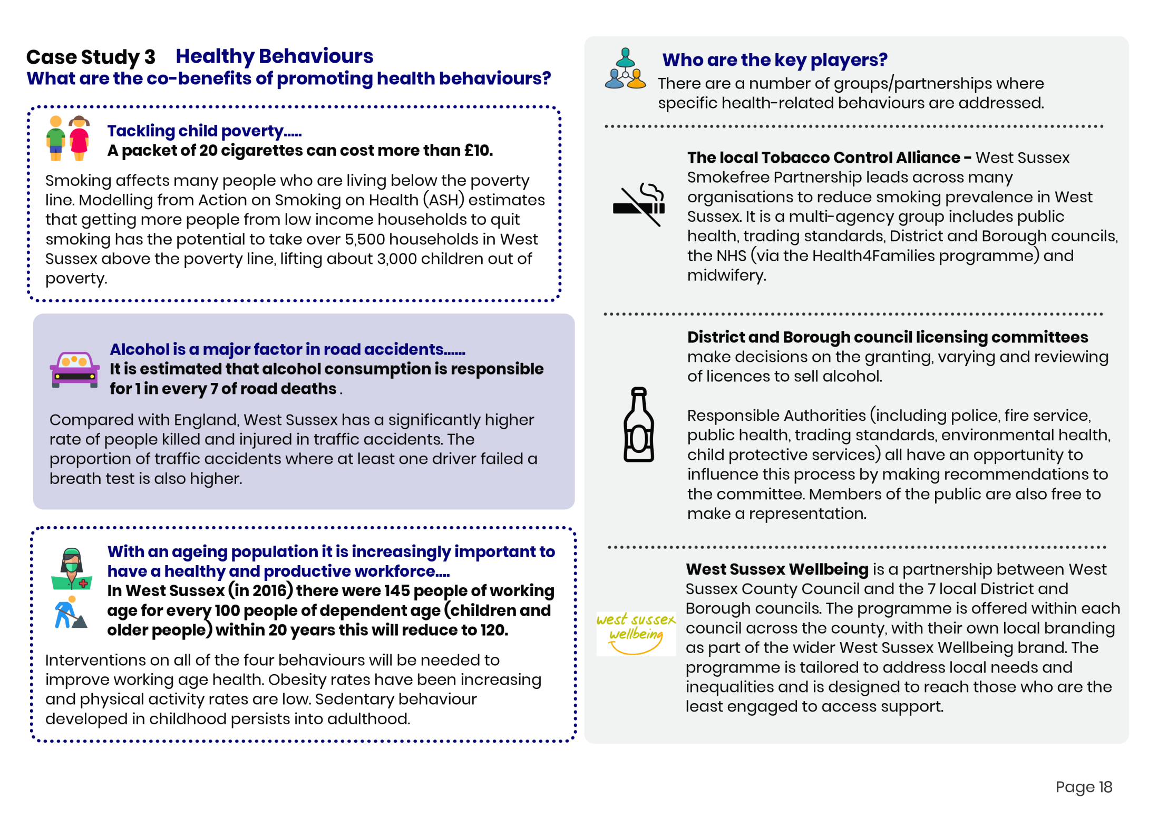
Co-benefits of tackling unhealthy behaviours….benefits don’t just sit in the “health sector”.

Slide 17
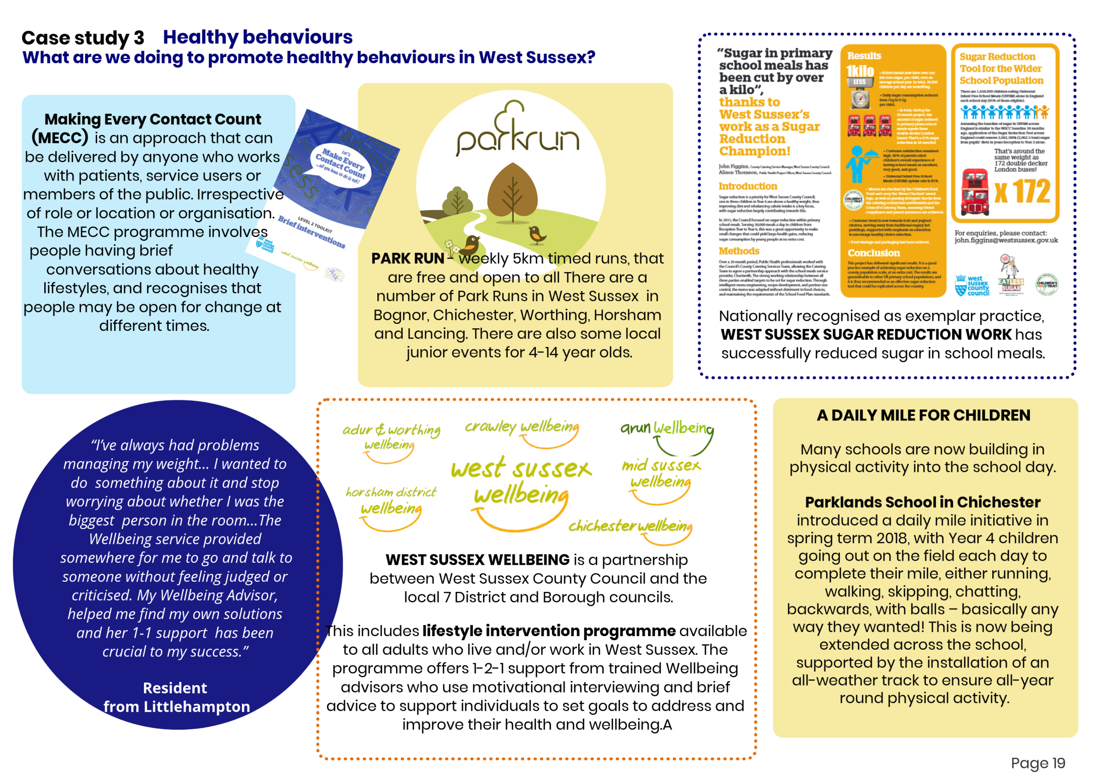

Slide 18
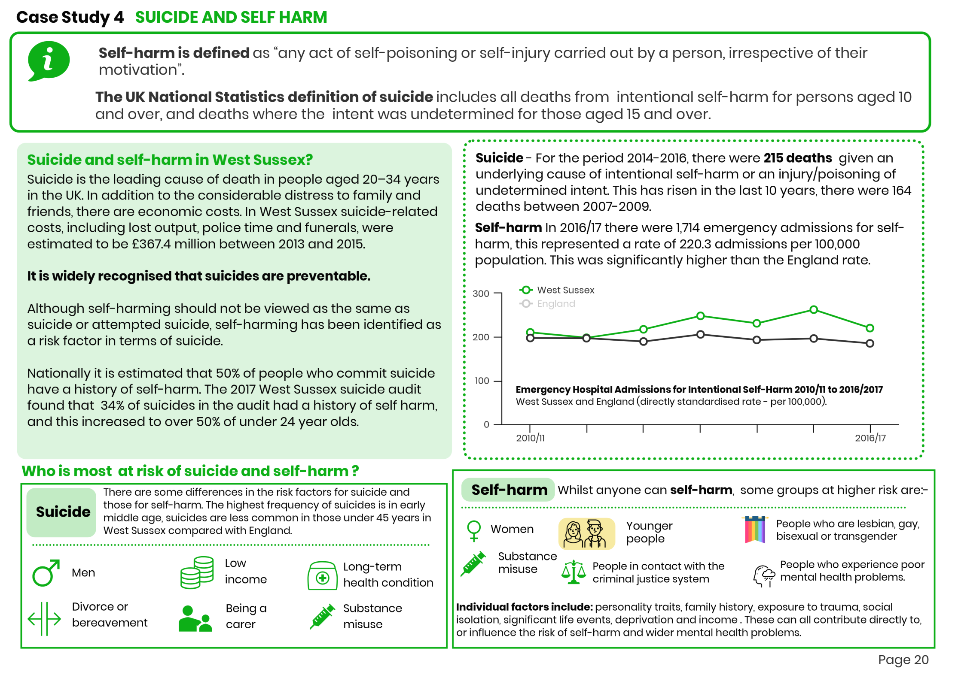

Slide 19
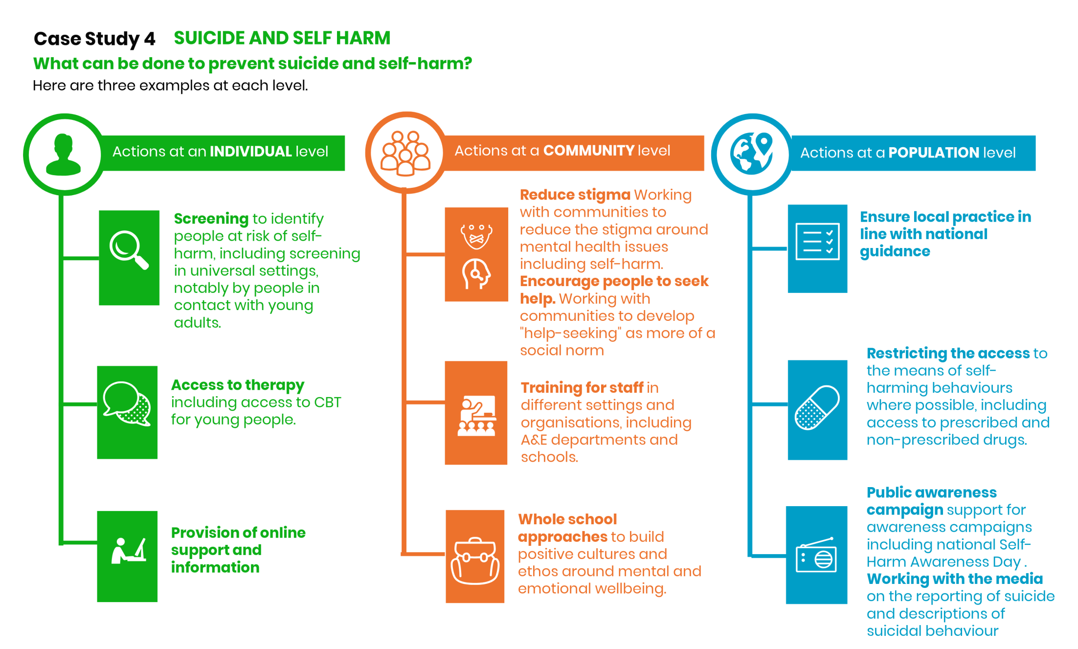

Slide 20
